Slide 1


The Well Visit Planner Orientation Webinar
December 3, 2012
Engaging Parents as Partners to Customize and Improve Well-Child Care for Young Children and their Families (www.wellvisitplanner.org)

Slide 2

Thank You for Joining the Webinar!
Presentation: To hear the presentation dial 1-800-985-7366 password=38645#
Asking Questions:
  Option 1: Type questions onto the screen in Adobe Connect.
  Option 2: Wait until we open the phone line to ask questions “live”
Getting materials: Slides, video and other informational materials are posted at www.WellVisitPlanner.org

Slide 3
Today’s Agenda
Overview of Tools
Development and Demonstration
Questions and Partnering

Slide 4
Motivation
Gaps Persist
Persistent gaps in the quality of well child care and the nation’s capacity to promote the healthy development of young children
Tailored Communication Essential
Improving care means :
Meet Goals with Greater Ease and Efficiency
The easy to use Well Visit Planner tools help providers efficiently meet their well-visit quality goals
meeting the unique priorities and needs of each child and family
improving communication and partnerships with parents and

Slide 5
What are the Well Visit Planner (WVP) tools?
Family-centered quality improvement
Parents learn about and identify priorities and key issues prior to visits
Access to educational materials and discussion tips
Enable customization and optimal use of visit time
Available for the 4, 6, 9, 12, 15, 18, 24 and 36 month well -visits
Bright Futures defined visit-specific focus areas

Slide 6
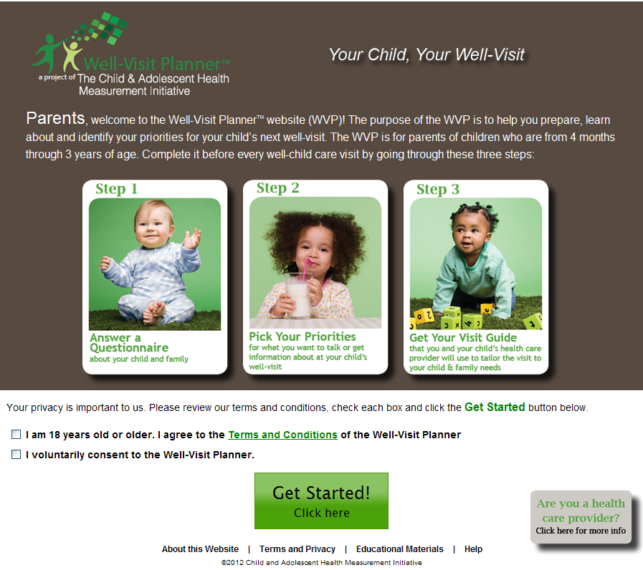
What are the Well Visit Planner (WVP) tools?
Feature Tool: An online pre-visit planning website for parents to complete prior to their child’s well-visit

Slide 7
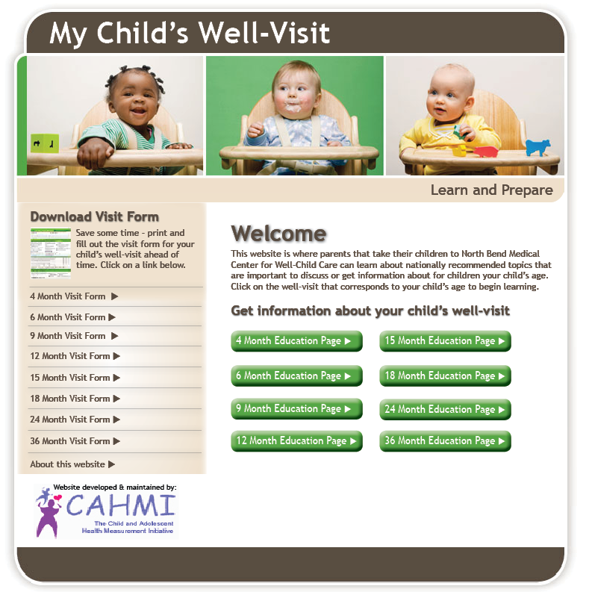
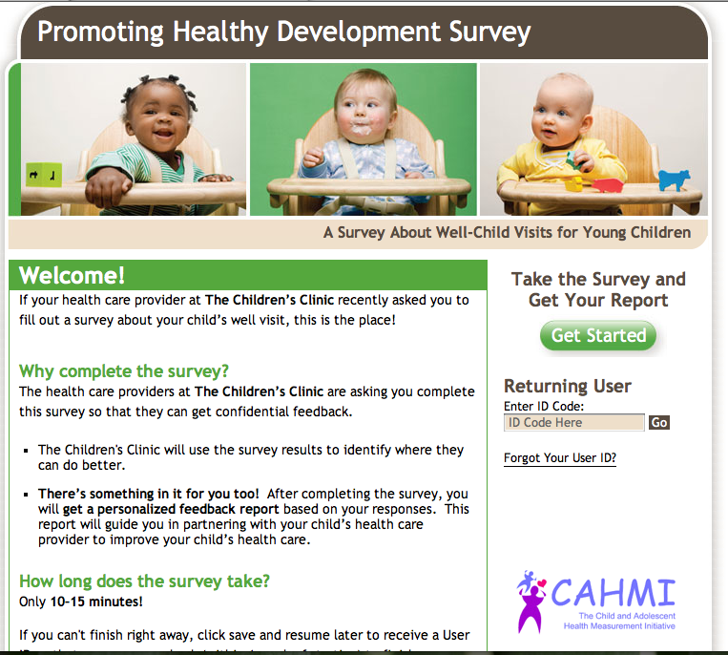
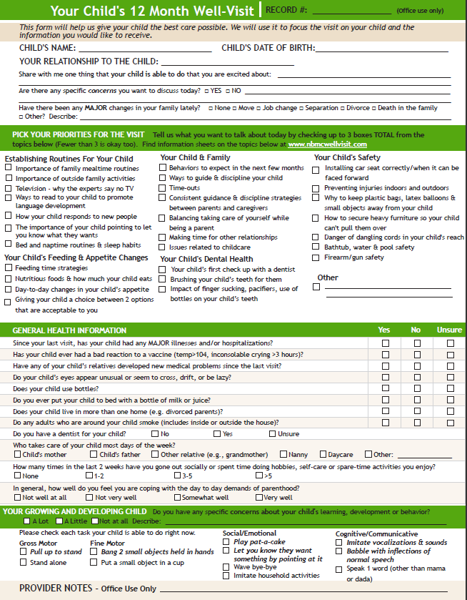
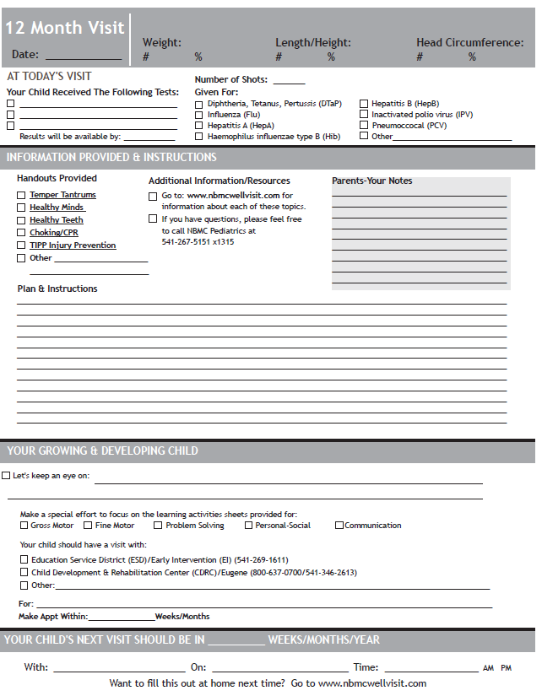
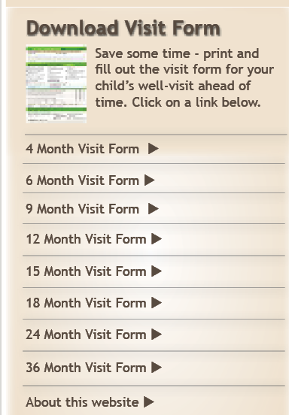
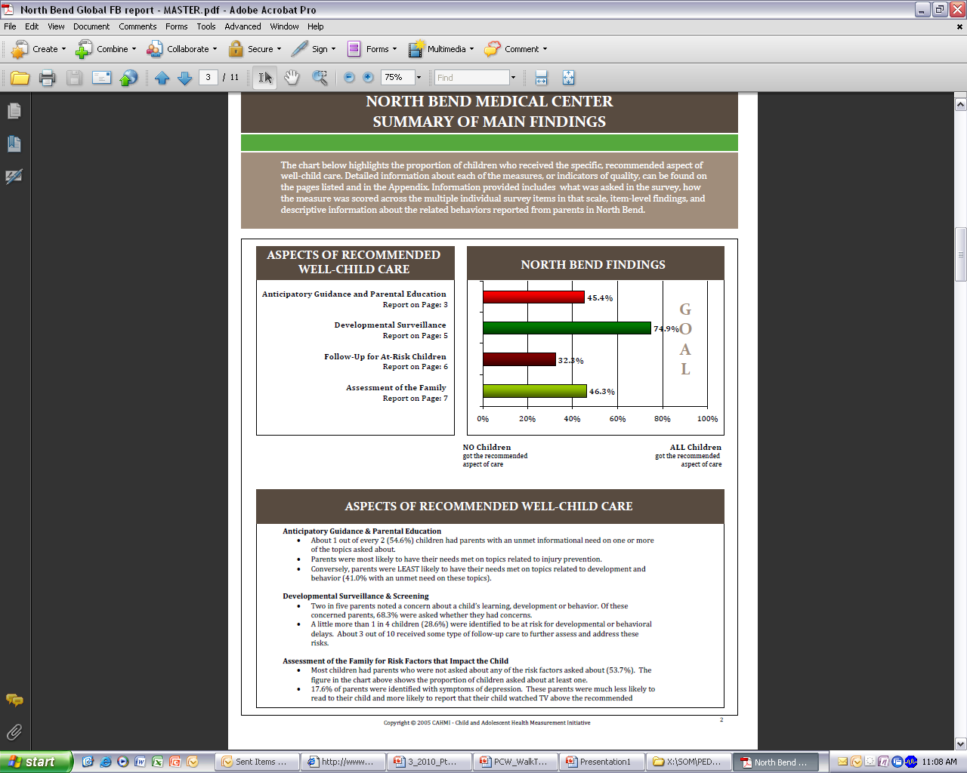
What are the Well Visit Planner (WVP) tools?
  Other tools: Shared Encounter Forms; Educational Materials Website; Online Quality Survey;

Slide 8
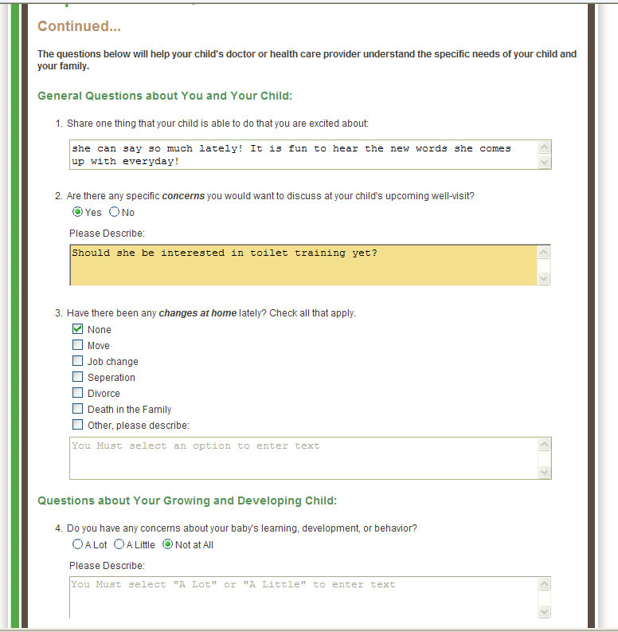
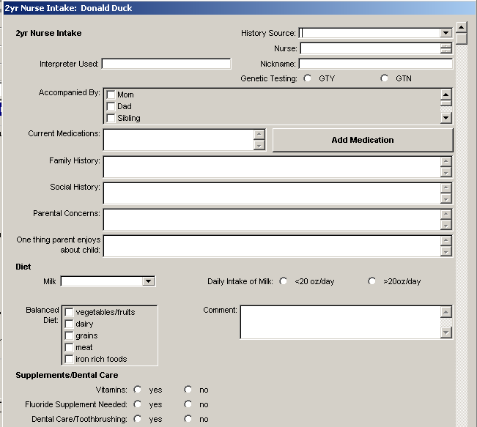
What is the Well Visit Planner (WVP)?
  Other tools: Possibility for integrating parent responses about priorities, key issues and needs (etc.) into the electronic health record
[Parent report: Should she be interested in toilet training?]

Slide 9
The Well Visit Planner (WVP) Website?

Slide 10
Development & Feasibility (1)
Research:
  Developed and tested over 4 years by the CAHMI for use in pediatric practices to assess: (1) Feasibility; (2) Acceptability; (3) Implementation Requirements; (4) Impact
  Drew on prior knowledge of using the online Promoting Healthy Development Survey to assess quality of well child care in practices
  Funded through an R40 grant from the federal Maternal and Child Health Bureau with additional MCHB support to complete the public use website for dissemination
Content:
  Anchored to the American Academy of Pediatrics’ Bright Futures Guidelines for Health Supervision of Infants, Children and Adolescents, 3rd edition
Advisors:
  National experts, families and pediatric providers collaborated in the design, content specification, all aspects of development, implementation and testing of the WVP tools
  Goals: ensure feasibility and to optimize impact on the quality and efficiency of the well child visit for parents, children and provider teams

Slide 11
Development & Feasibility (2)
Initial testing documented improvements to provider office work flow, patient engagement and experience and quality of care
  Over 92% of the 3000 parents included in the initial testing reported:
    They would recommend the tool to other parents
    They were comfortable with time required to complete the tool
    Tool helped them understand goals for each well visit and prioritize topics for discussion with their child’s health care providers
The WVP was recognized in the Health 2.0/Academy Health 2012 Relevant Evidence to Advance Care and Health competition
Relevant to meaningful use and maintenance of certification

Slide 12
The Well Visit Planner Website: Three Steps
Parents of young children visit the Well-Visit PlannerTM website and complete the following steps before their child’s age-specific well visit:

Slide 13
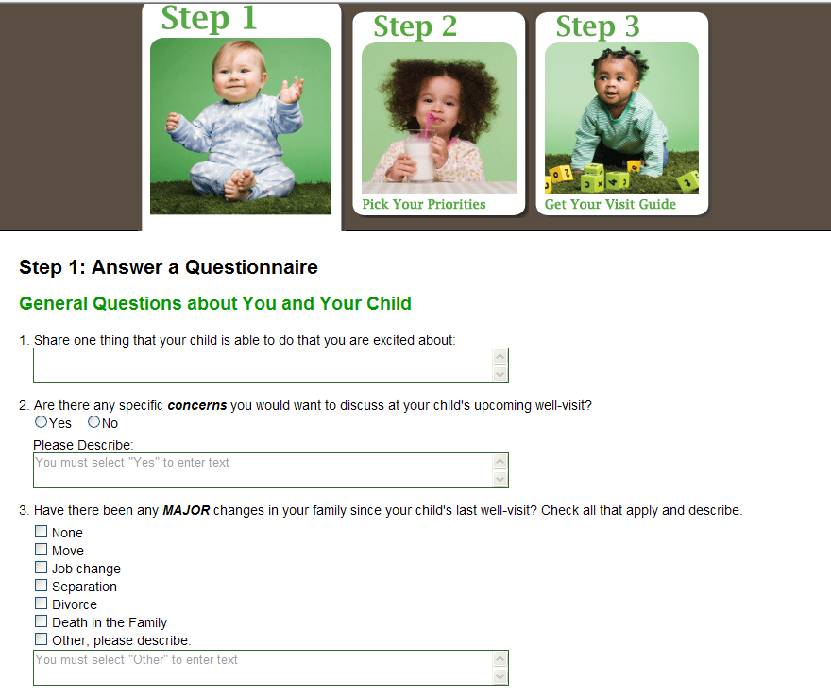
Flow and Content
A strengths and observations based approach as well as addressing any issues parents want to discuss right at the start of the tool
Important family changes and health information

Slide 14
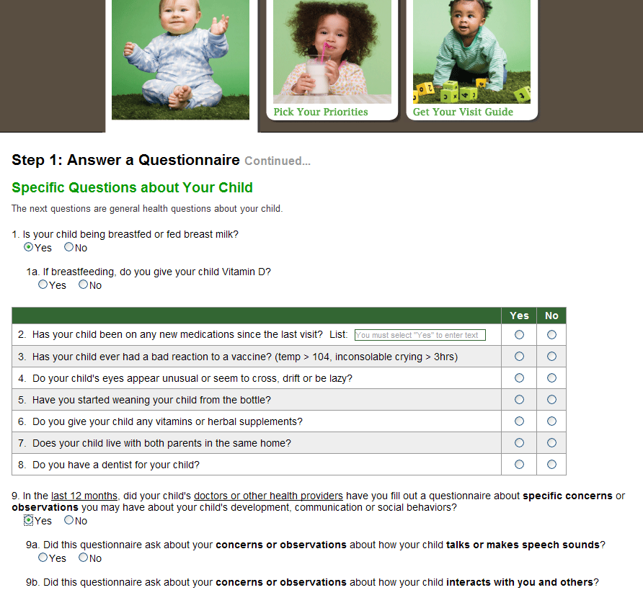
What is in the WVP?
Child health and functioning (e.g. feeding, immunizations etc.)
Assessment of a prior developmental screening questionnaire being filled out by parent

Slide 15
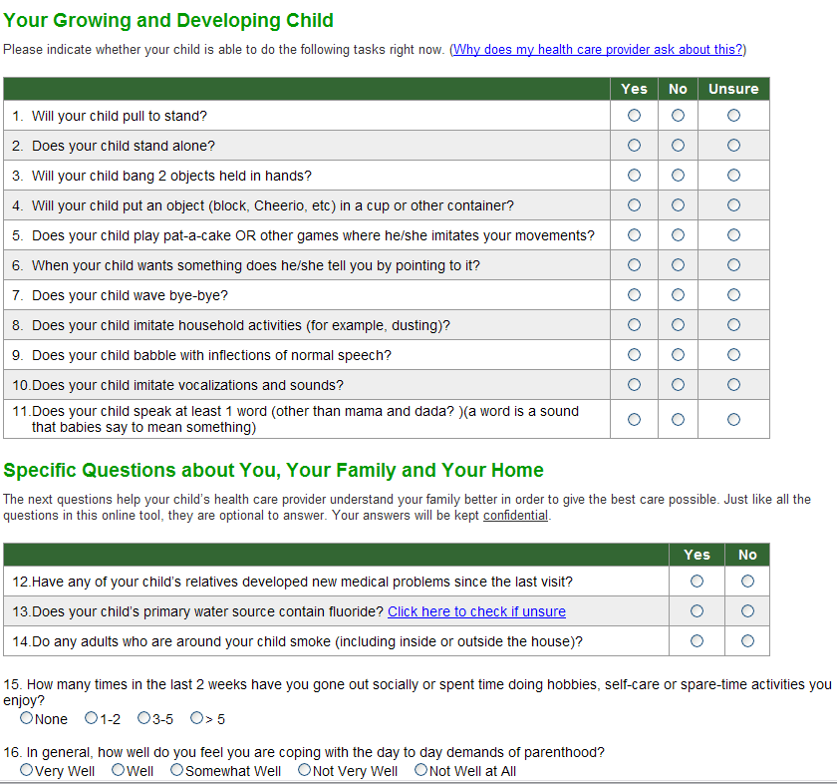
Age-specific developmental surveillance
Important family psychosocial assessment items

Slide 16
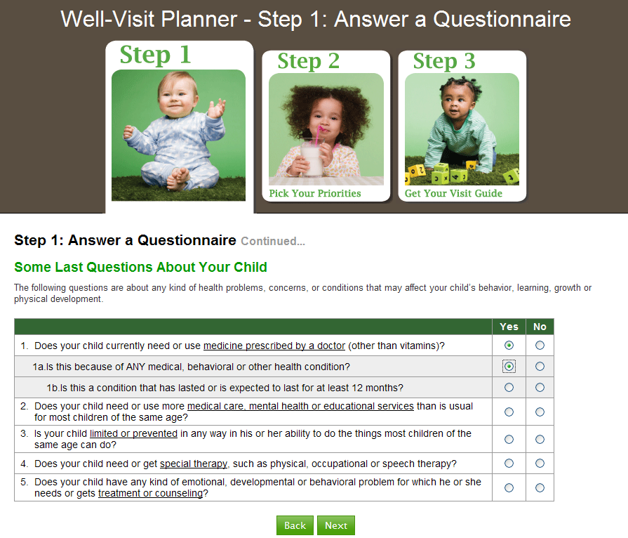
Identification of children with special health care needs using the validated CSHCN Screener

Slide 17
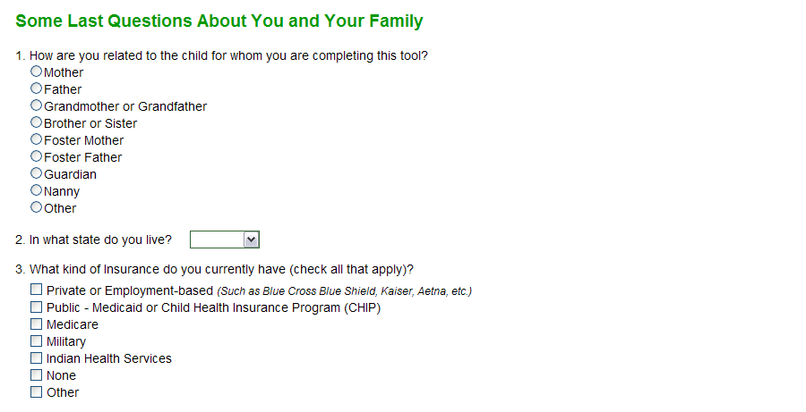
Flow and Content
Basic demographic items

Slide 18
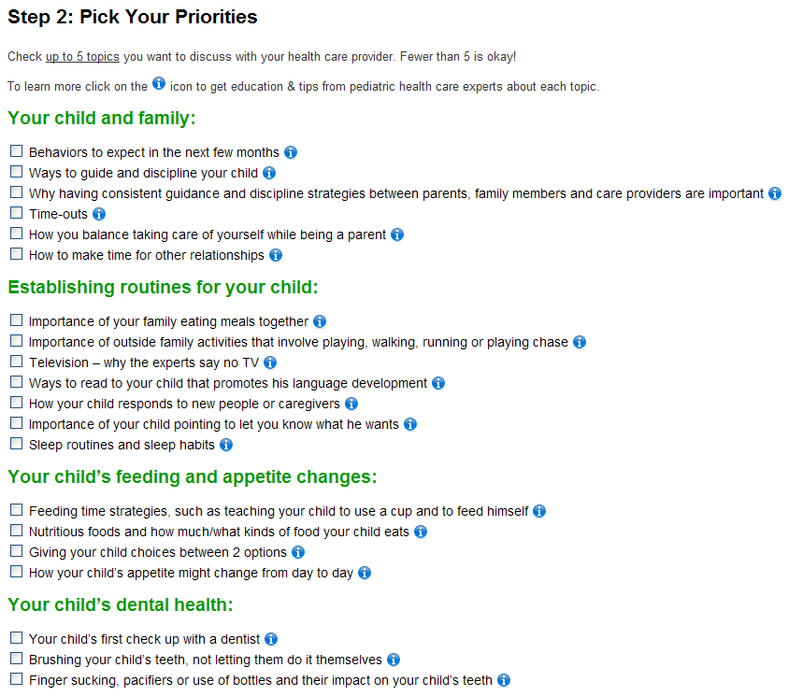
What is in the WVP?
Extremely important prioritization and educational information about what is customary from the age-specific well-child visit

Slide 19
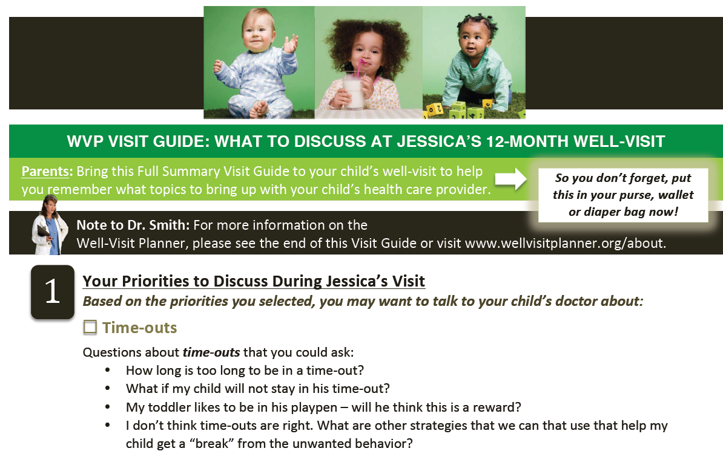
Voila! The Visit Guide
After completing the tool, a customized visit guide is generated for use by both parents and their child’s health care provider(s). The entire online time for most parents is roughly 10 minutes

Slide 20
Demonstration of the Public Use WVP
Engage
Educate
Improve
http://youtu.be/eG-fFjfyqnY
Reminder: Audio will be coming through your computer, not through the phone - please make sure your speakers are on

Slide 21
Selecting the Right tool(s)
Engage
Educate
Improve
in your clinic

Slide 22
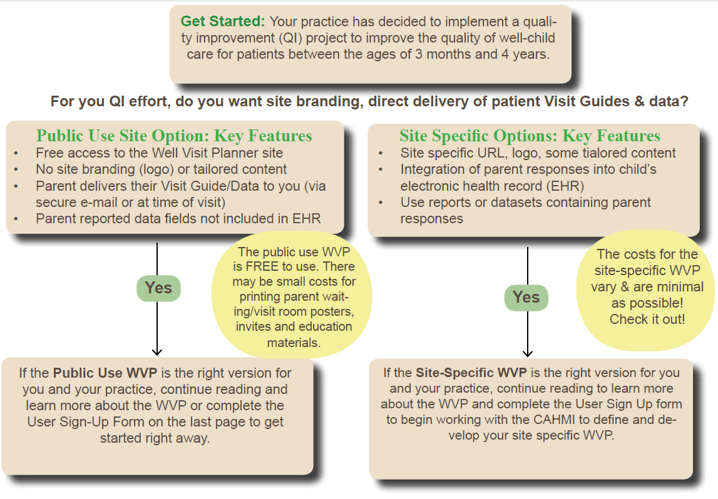
Two Primary Options
1) Free public use website…start now! 2) Site-specific website

Slide 23
IMPLEMENTING the WVP
Engage
Educate
Improve
in your clinic

Slide 24
What is Needed for Using the WVP?
  A desire to focus on quality improvement
  A willing and engaged clinic staff
  The desire to create a culture of engagement
  An adaptable office flow
  Bonus: An EHR system that can accept incoming patient-provided data!

Slide 25

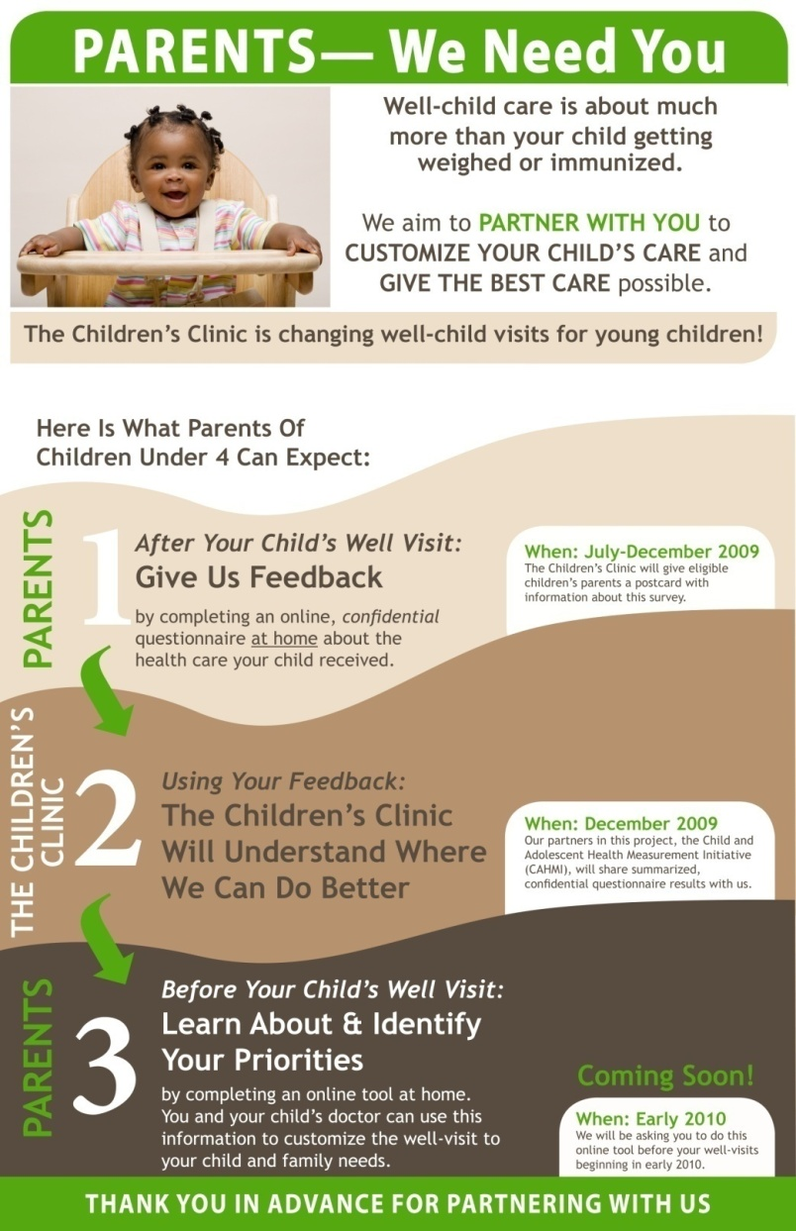
Cultural Shift for Your Patients
  Families may not be accustomed to being engaged, particularly prior to a visit
  A friendly office environment with posters about the desire and need for families to engage— “We need your participation!”
  Encouragement that doing the WVP ahead of time is best for the provider and the family, and the child will benefit

Slide 26
Requirements for all Versions of the WVP
 | Implementation Options
Requirements | Public Use Site WVP | Unique Clinic URL for WVP | Site-specific URL, Branding | Site specific URL with customized content | EHR Integration of Visit Guides (PDF) | Full EHR Integration Module
Engage Staff (Develop culture of engagement, momentum and office champions) | X | X | X | X | X | X
Engage patients (Develop posters and engagement materials) | X | X | X | X | X | X
Office Flow (Work to include engagement into flow of well-child visits) | X | X | X | X | X | X
Develop EHR system for inclusion of PDF |  |  |  |  | X
Develop EHR system for manual import of HL7 file |  |  |  |  |  | X
Develop EHR forms for full automated integration of data into visit |  |  |  |  |  | X

Slide 27
Office Flow
1
Communicate with your patients about completing the WVP prior to their appointment
2
Parents go to www.WellVisitPlanner.org and engage with with the interactive website, including age-specific questions and educational materials
3
Parents view, save and print their customized Visit Guide to bring to their child’s appointment. They can also email it to the office ahead of time via a secure email connection.
Email, fliers, posters, postcards, phone calls, etc. (Example materials will be available in the implementation toolkit)
4
Enhanced patient encounter: parents come to the visit prepared, doctors/nurses are prepared to use the visit guide to focus on parental priorities and concerns. Less time needed to ask developmental questions so more time to address developmental concerns and family psychosocial issues

Slide 28
Office Flow
Clinic Scheduler
* Children with upcoming well-child care visits who are eligible for parents to participate in Well Visit planner are identified
* Five days before well-child visit, parent is reminded about visit and told to go to website. This can be done along with a practice’s existing process, i.e. telephone and/or email appointment reminder.
Parent
*Some (not all) parents complete tool AT HOME
*Parent prints Visit Guide at home
*Parent can visit WVP educational material website anytime
Front Desk Check In
* Aware of the project and able to answer questions
MA/RN
* Asks eligible/invited parents if they filled out the WVP
* Ask parent for Visit Guide to make a photocopy for health care provider to use during visit and for the patient’s record
* Review Visit Guide and follow up on any items appropriate for MA/RN to discuss with parent, make entries/notes in chart or electronic health record
During Visit
Provider
* Review Visit Guide and MA/RN notes, if applicable
* Address parent’s concerns, priorities and health screening flags
* Guide parent to parent education materials on website
After Visit
Parent
* Can go back to website for the educational materials and resources
Before Visit

Slide 29
Available upon launch of public site… (January 2013 )
  A full implementation toolkit for use with the FREE Public Use version of the WVP
  Coming soon: A unique URL for your clinic
  Coming soon: Enhanced features (such as the ability to integrate data directly into the EHR, customize content of the WVP and brand the site with your clinic logo)
  But you can start preparing to use
  the Well Visit Planner tools now!

Slide 30
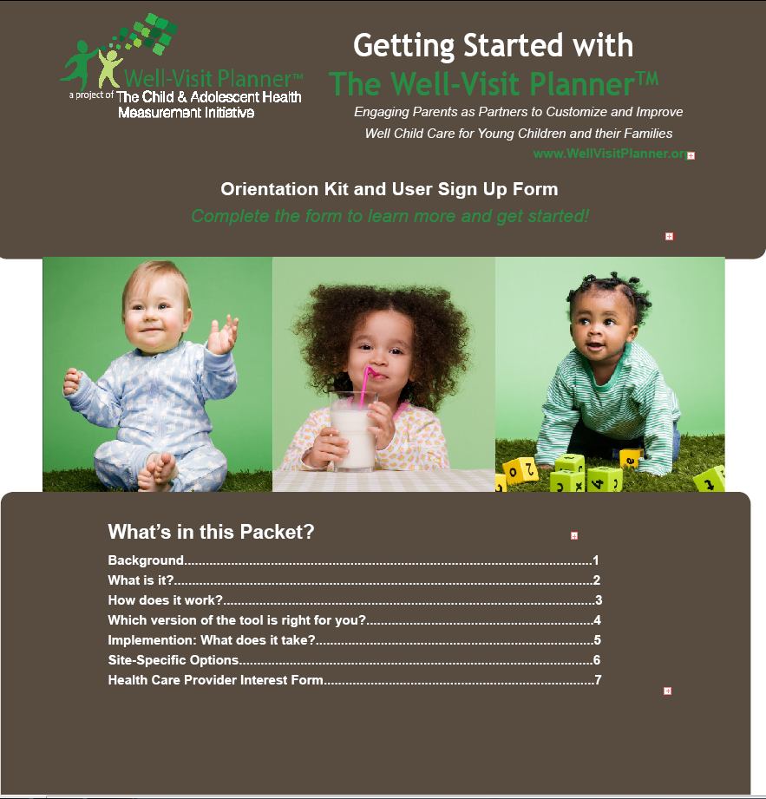
Get Started with the Orientation Kit and Users Sign Up Form
Improve

Slide 31
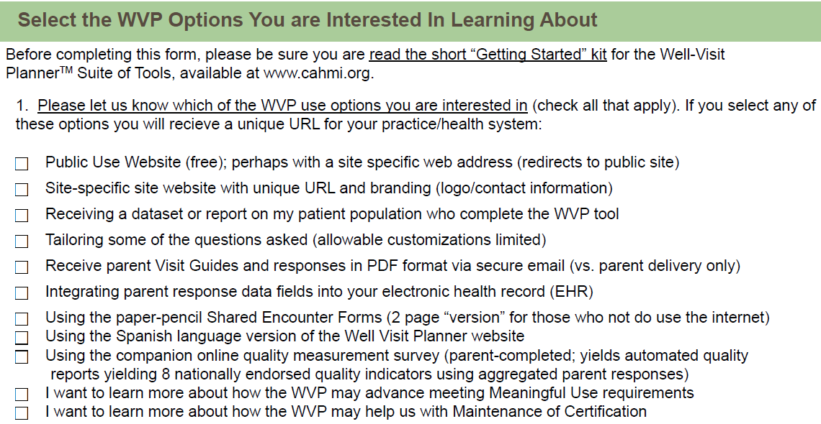
User Sign-Up Form

Slide 32
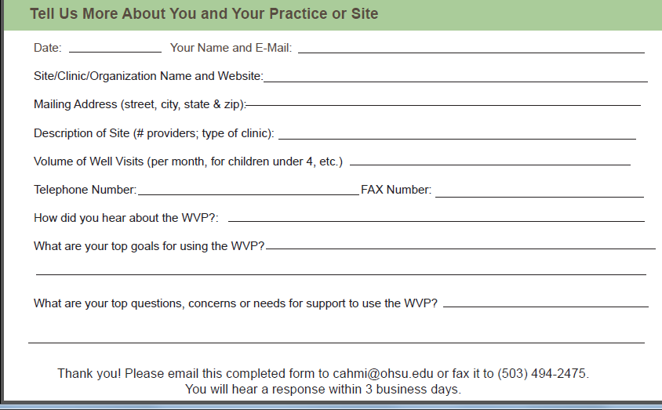
User Sign-Up Form
Available at www.wellvisitplanner.org

Slide 33
Thank You to Our Many Partners
Thank you to all of the staff, advisors and family involvement in the development of the WVP website
The staff at the Child and Adolescent Health Measurement Initiative
The entire staff at The Children’s Clinic in Tigard, Oregon
The federal Maternal and Child Health Bureau
Parent Advisors
Tami Olson
Emily Brophy
Kellena Collier
Amy Kurian
National Advisory Committee
Betsy Anderson Cynthia Minkovitz
Jane Basowitz Amy Perretti
David Bergman Edward L. Schor
Greg Blashke Judy Shaw
Dimitri A. Christakis Sara Slovin
John Kilty
Paula Duncan

Slide 34
Thank you!
  We would love to partner with you!
  Contact Information:
  Christina Bethell
  Phone: 503-494-1892
  Email: bethellc@ohsu.edu
  Fax: 503-494-2475
  The CAHMI
  Phone: 503-494-1930
  Email: CAHMI@ohsu.edu
  Website: www.cahmi.org
  www.WellVisitPlanner.org

Slide 35
Questions?
Engage
Educate
Improve
Press *6 to unmute your line and ask a question

